Slide 1


5 tips to up your Power BI Game in 5 Minutes
Ashley Warren
Senior Analytics Consultant @
Advancing Analytics

Slide 2
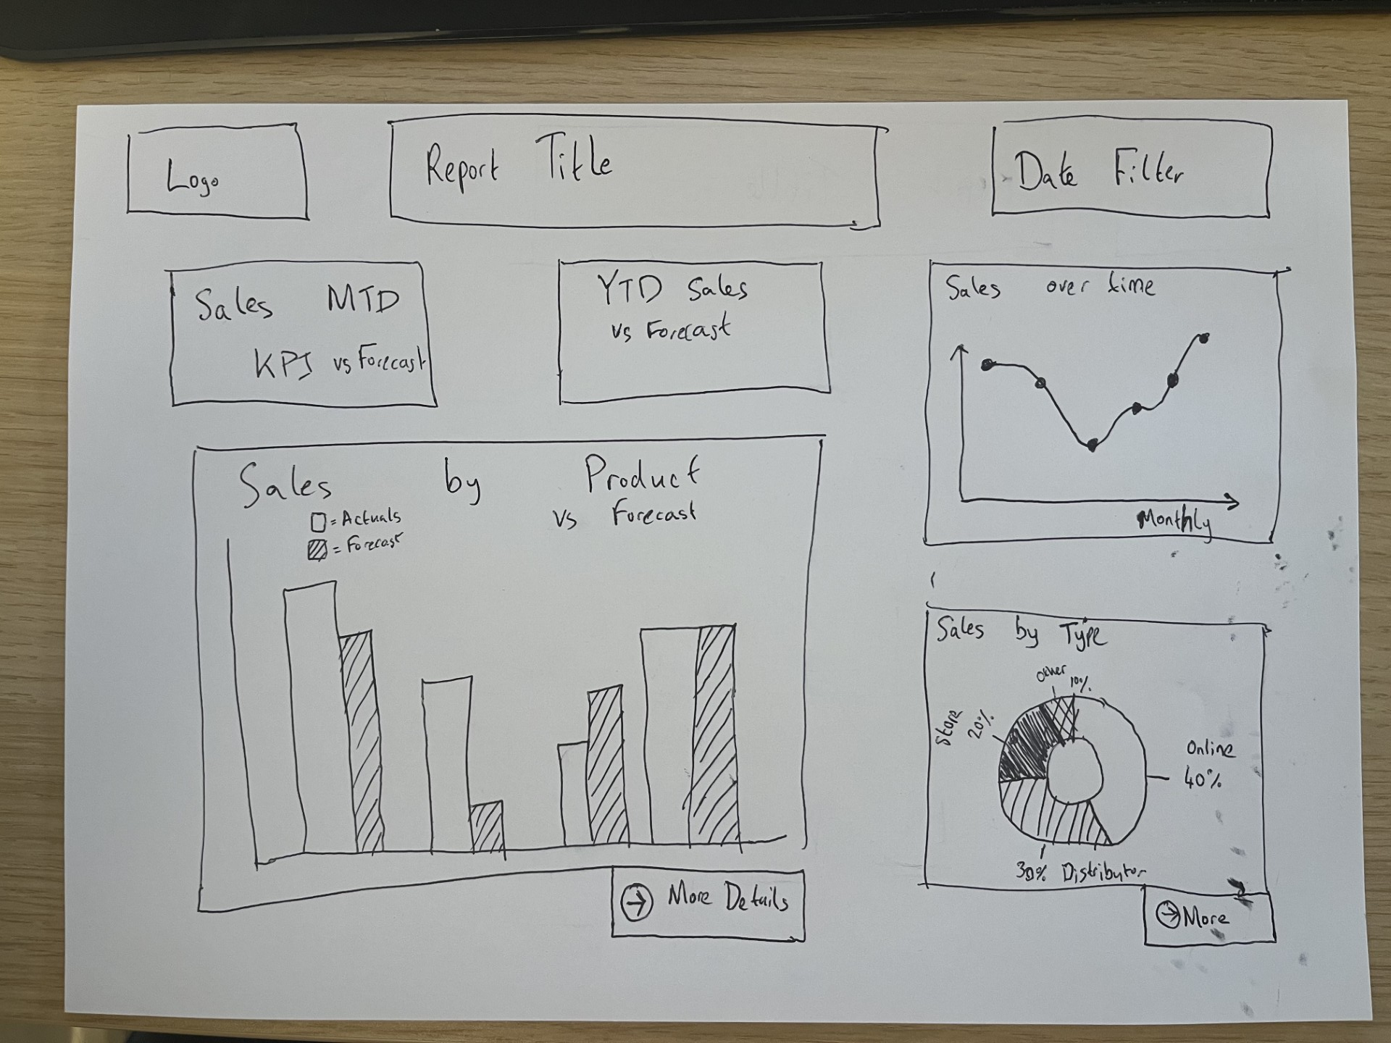
Wire Framing
Tip 1
Before jumping into PowerBI desktop to build a new report, you should create a wireframe design
Even if it’s just a quick 10 minute sketch, it makes the end product clearer and identifies likely user problems quicker
Share the sketch early – getting end users on board early helps in the long run
Even better if you can get your stakeholders to draw the wireframe for you! If they can’t then maybe the report scope isn’t clear enough yet!

Slide 3
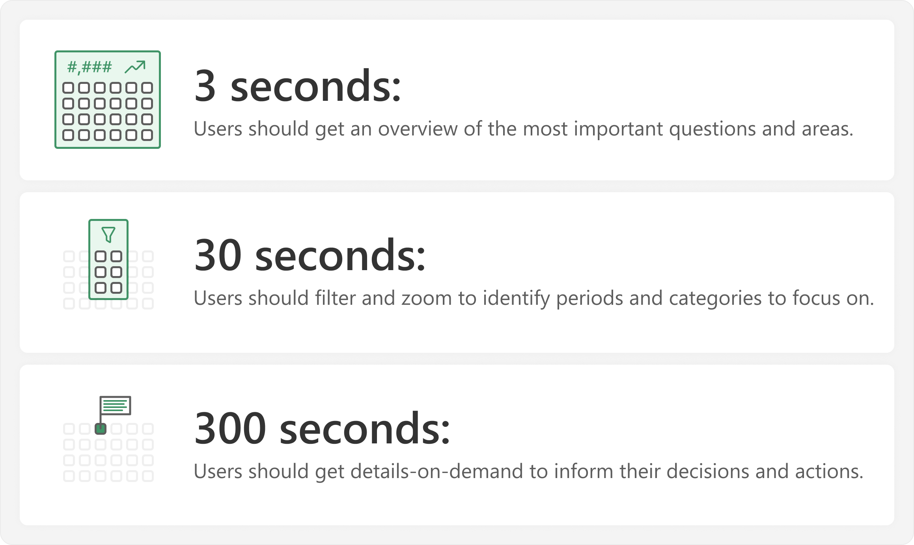
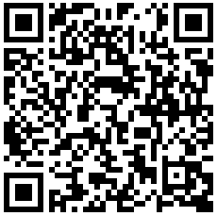
3 / 30 / 300 Rule
Concept is based on visual information-seeking mantra from Ben Schneidermann (1996)
SQLBI applied it to Report design in their article here:
Tip 2

Slide 4
Report 1
Bad Design

Slide 5
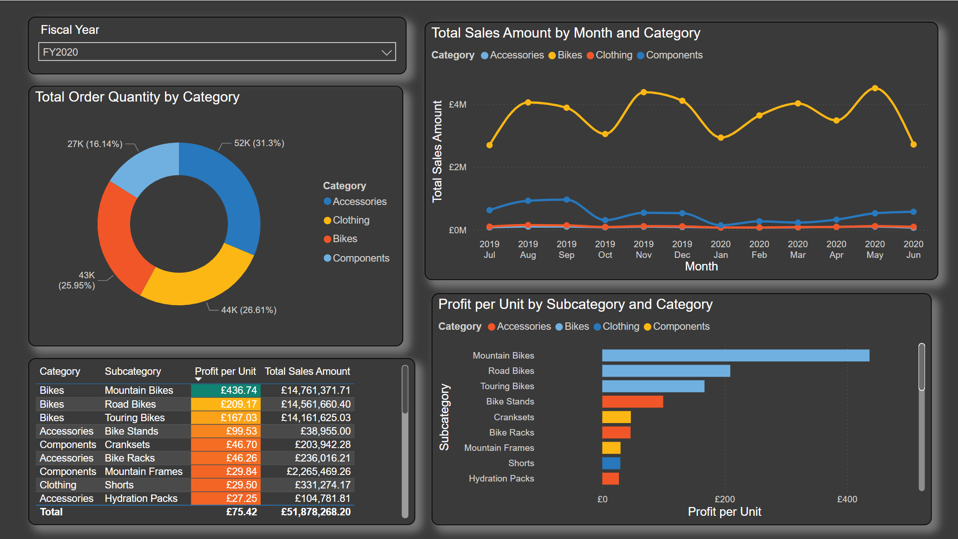

Slide 6
Report 2
Better Design

Slide 7
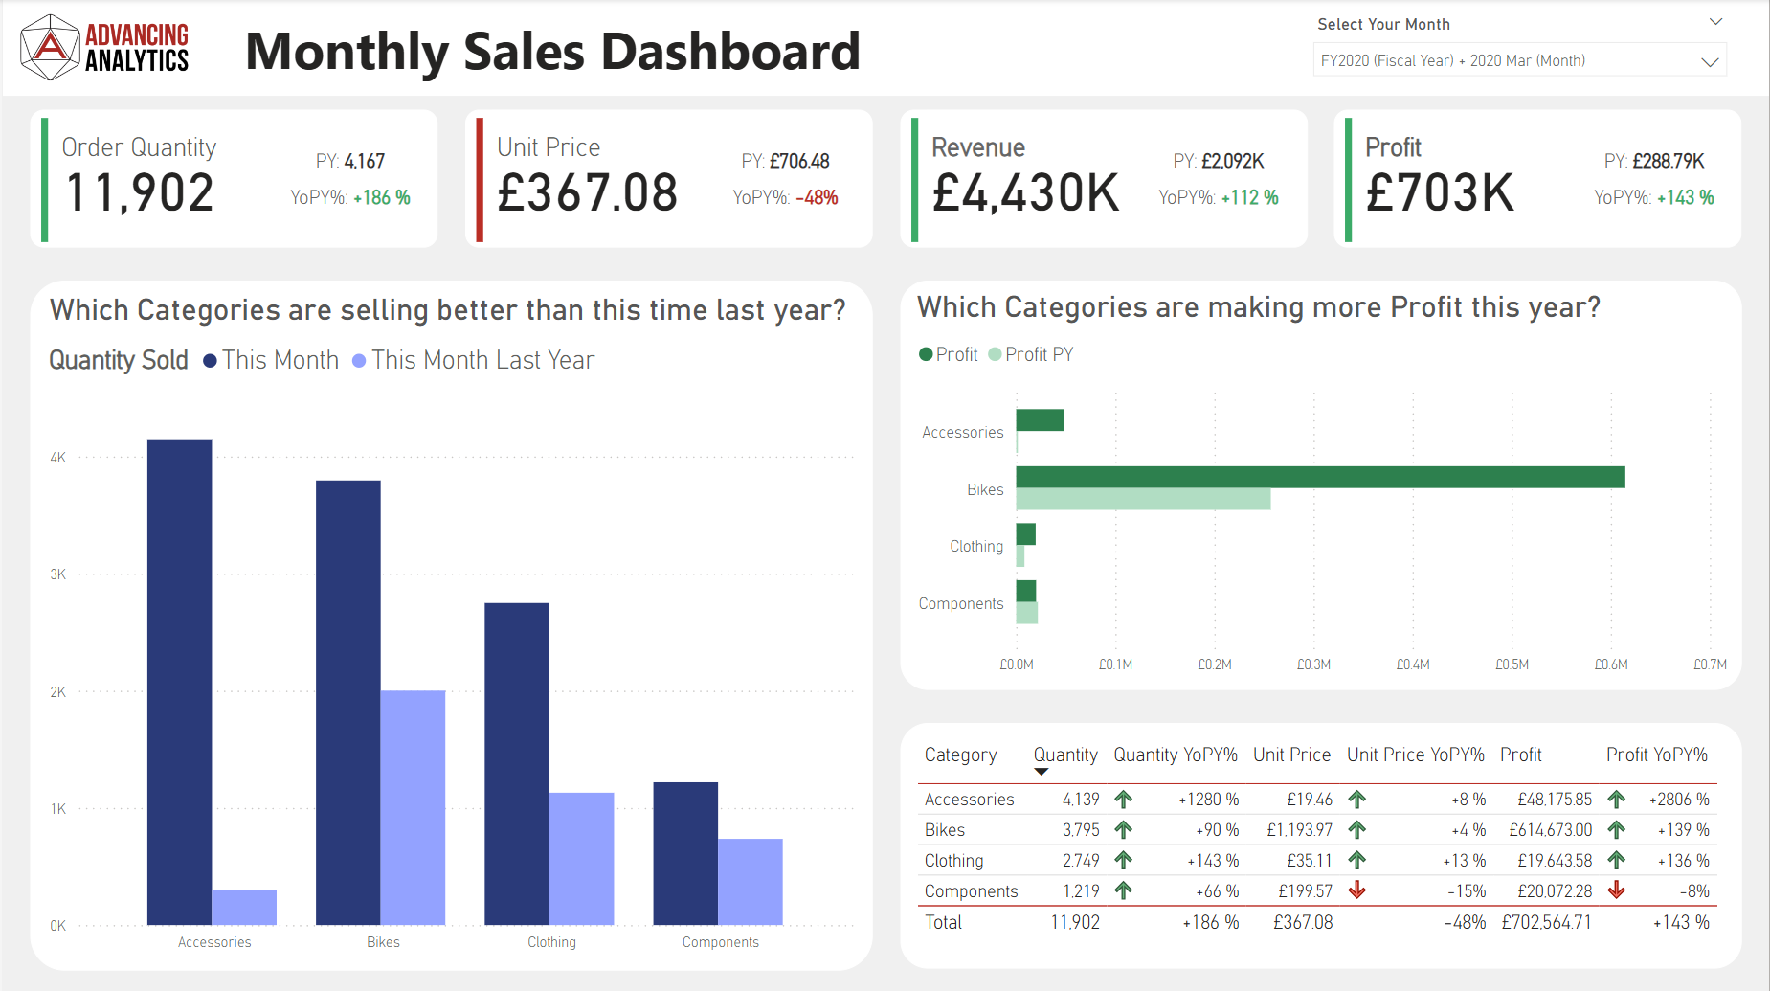

Slide 8
Hopefully, you can see how much more intuitive Report 2 is!
Make your end user’s life as simple as possible!

Slide 9

Tabular Editor
Tip 3
In my opinion, it’s the single biggest Power BI productivity boost out there
There is a free version Tabular Editor 2 & the paid for version Tabular Editor 3
TE2, has an array for features, including:
Batch measure editing
Best Practice Analyser
Advanced Data Modelling - OLS, Perspectives, Calculation Groups, Partitions, etc.
C# Scripting for Model changes
Model “Save to Folder” File Format
It’s now recommended by Microsoft as part of their DP-600 Fabric Analytics Engineering course

Slide 10



Workspace Git Integration
CI/CD in PowerBI
PBIP File Formats
Deployment Pipelines
Link your fabric workspaces to a git repository and gain all the benefits of automated version control. Git helps you identify how, when and who changed files.
PBIP file format allows you to split out your PBIXs into a series of files. It gives a better experience with version control & enables multiple developers to work on one report
Deployment pipelines allow you to deploy reports & models through a chain of workspaces (e.g. Dev, Test and Prod). They help you ensure changes are deployed in a robust manner
Tip 4

Slide 11

Atomic Design
Read the SQLBI article on Atomic Design:
Theme Templates
Backgrounds
Visuals
Investing time in creating a theme file
Themes are more than just a colour palette
You can set defaults for nearly every formatting option down to a per visual type level
I have a series of static PNG report backgrounds I can load into a report page to give instant structure
It saves time and creates more consistent layouts
I keep a template report file full of visuals and report items I might want to re-use
I can quickly copy and paste pre-formatted visuals into new reports
It’s especially handy with cards!
Tip 5

Slide 12
Atomic Design
Read the SQLBI article on Atomic Design:
Theme Templates
Backgrounds
Visuals
It’s really important to align these
across all the developers in your organisation
Consistent design pays dividends in user understanding
Investing time in creating a theme file pays dividends
Themes are more than just a colour palette
You can set defaults for nearly every formatting option at a per visual type
I have a series of static PNG report backgrounds I can load into a report page to give instant structure
It saves time and creates more consistent reports
I keep a template report file full of visuals and report items I might want to re-use
I can quickly copy and paste pre-formatted visuals into new reports
It’s especially handy with cards and icons!
Tip 5

Slide 13
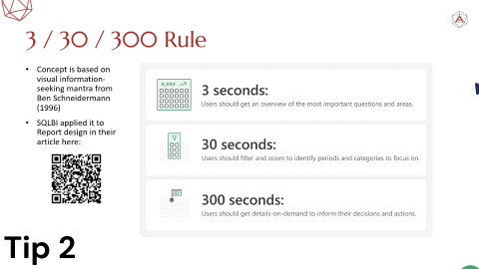
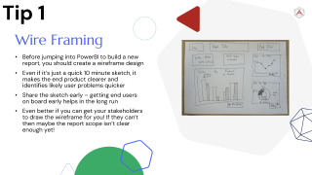
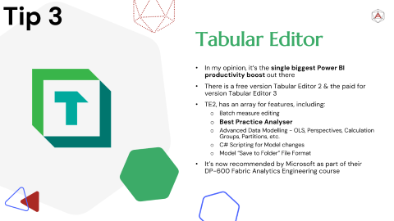
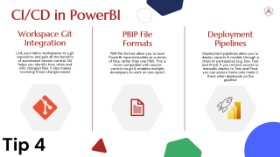
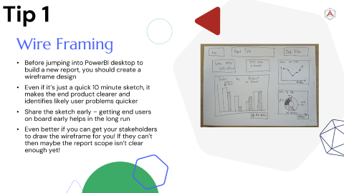
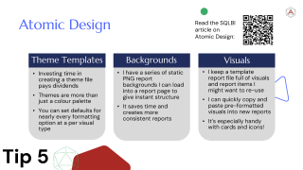




Thank you for listening!
Wire Framing
3 / 30 / 300 Rule
Tabular Editor
Learn to how to do CI/CD in Power BI
Take design inspiration from everywhere
1
2
3
4
5

Slide 14
Take design inspiration from everywhere
LinkedIn Stars
Mobile Apps
Media
There are design superstars you can follow on LinkedIn:
Injae Park
Bas Dohman
Elena Drakulevska
Valerie Junk
Nick Lea-Trengrouse
And many, many others!
People intuitively know how to use mobile apps
What can you learn from them?
Navigation
Hero visuals
Cohesive design
If something in media resonates with you, think about why
E.g. Video games have massive design teams & can teach about:
Framing
Story-telling
Etc.
Tip 5
Design inspiration is everywhere, if you look for it!

